Slide 1

DATA SCIENCE HACKATHON

Slide 2
Learn to do Data Science (Objective)
Create a interactive dashboard of COVID-19 updates using python (you can use voila).
Calculate the recovery rate by country and plot into a interactive dashboard.
Create best prediction model over recovery rate. (Use any algo)

Slide 3
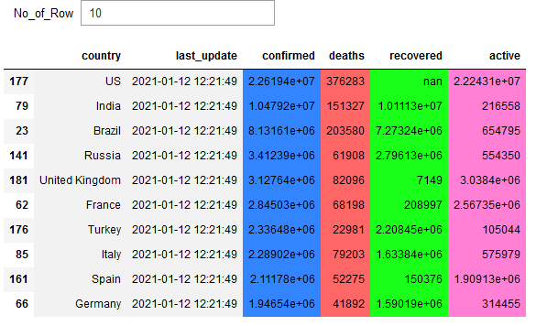
Create indexing of interactive table in python.

Slide 4
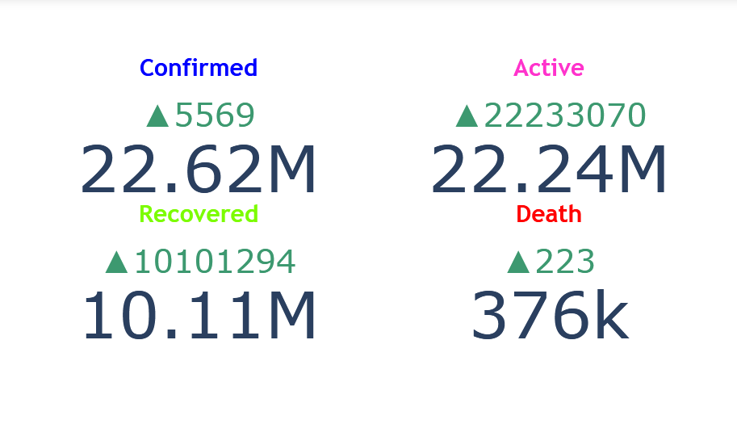
Create a Daily Indicator Counts

Slide 5
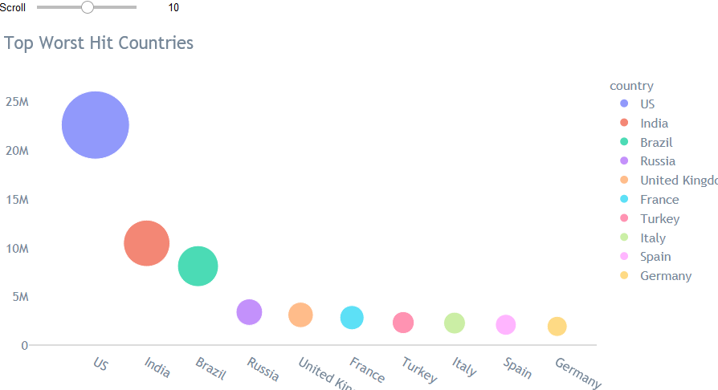
Create a bubble chart on top worst hit countries

Slide 6
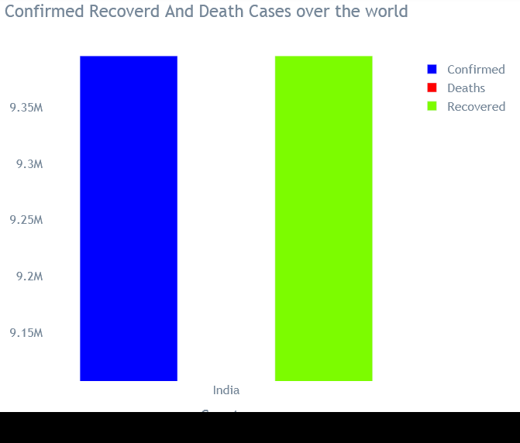
Create a bar chart of confirmed, recovered and death cases over the world

Slide 7
Data Links
Data Links:
https://raw.githubusercontent.com/CSSEGISandData/COVID-19/web-data/data/cases_country.csv
https://raw.githubusercontent.com/CSSEGISandData/COVID-19/master/csse_covid_19_data/csse_covid_19_time_series/time_series_covid19_deaths_global.csv
https://raw.githubusercontent.com/CSSEGISandData/COVID-19/master/csse_covid_19_data/csse_covid_19_time_series/time_series_covid19_confirmed_global.csv
https://raw.githubusercontent.com/CSSEGISandData/COVID-19/master/csse_covid_19_data/csse_covid_19_time_series/time_series_covid19_recovered_global.csv

Slide 8
The Home of Data Science & Machine Learning We help you learn, work, and play
Understand problem
Datasets
Submission
winner announcement

Slide 9

Challenge “YOURSELF”

